Slide 1
Thingsboard
What it can do

Slide 2
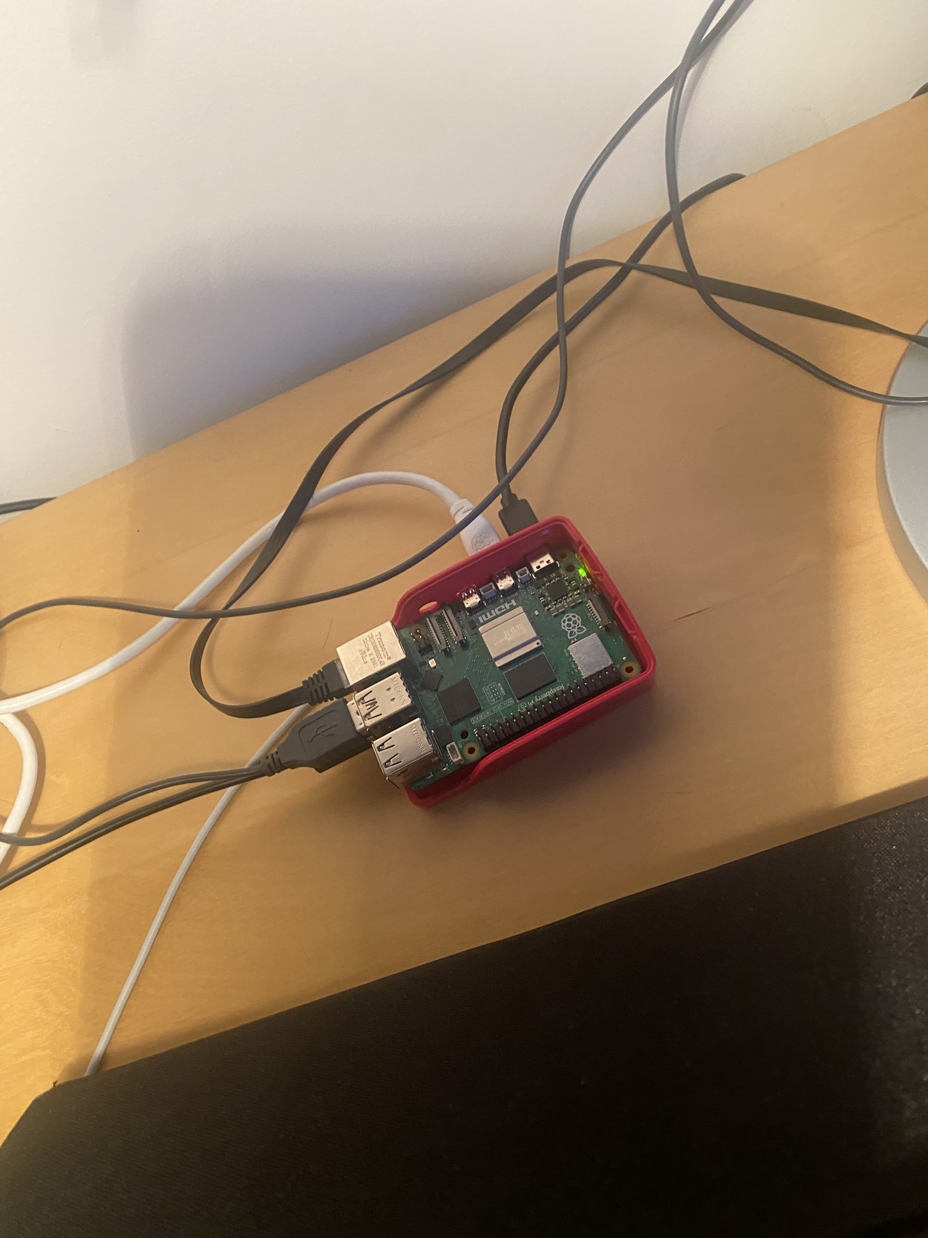
The server (≈70CHF)
Software:
Thingsboard server
Postgresql database
On router/modem:
Port forwarding so we can access it from the internet
http://178.83.48.13:8080/home
Setup time:
30min

Slide 3
User types
Sysadmin (only 1): can create tenants and server settings
Tenant: can connect devices, customers, rules, dashboards…
Customer: can view dashboards access control

Slide 4
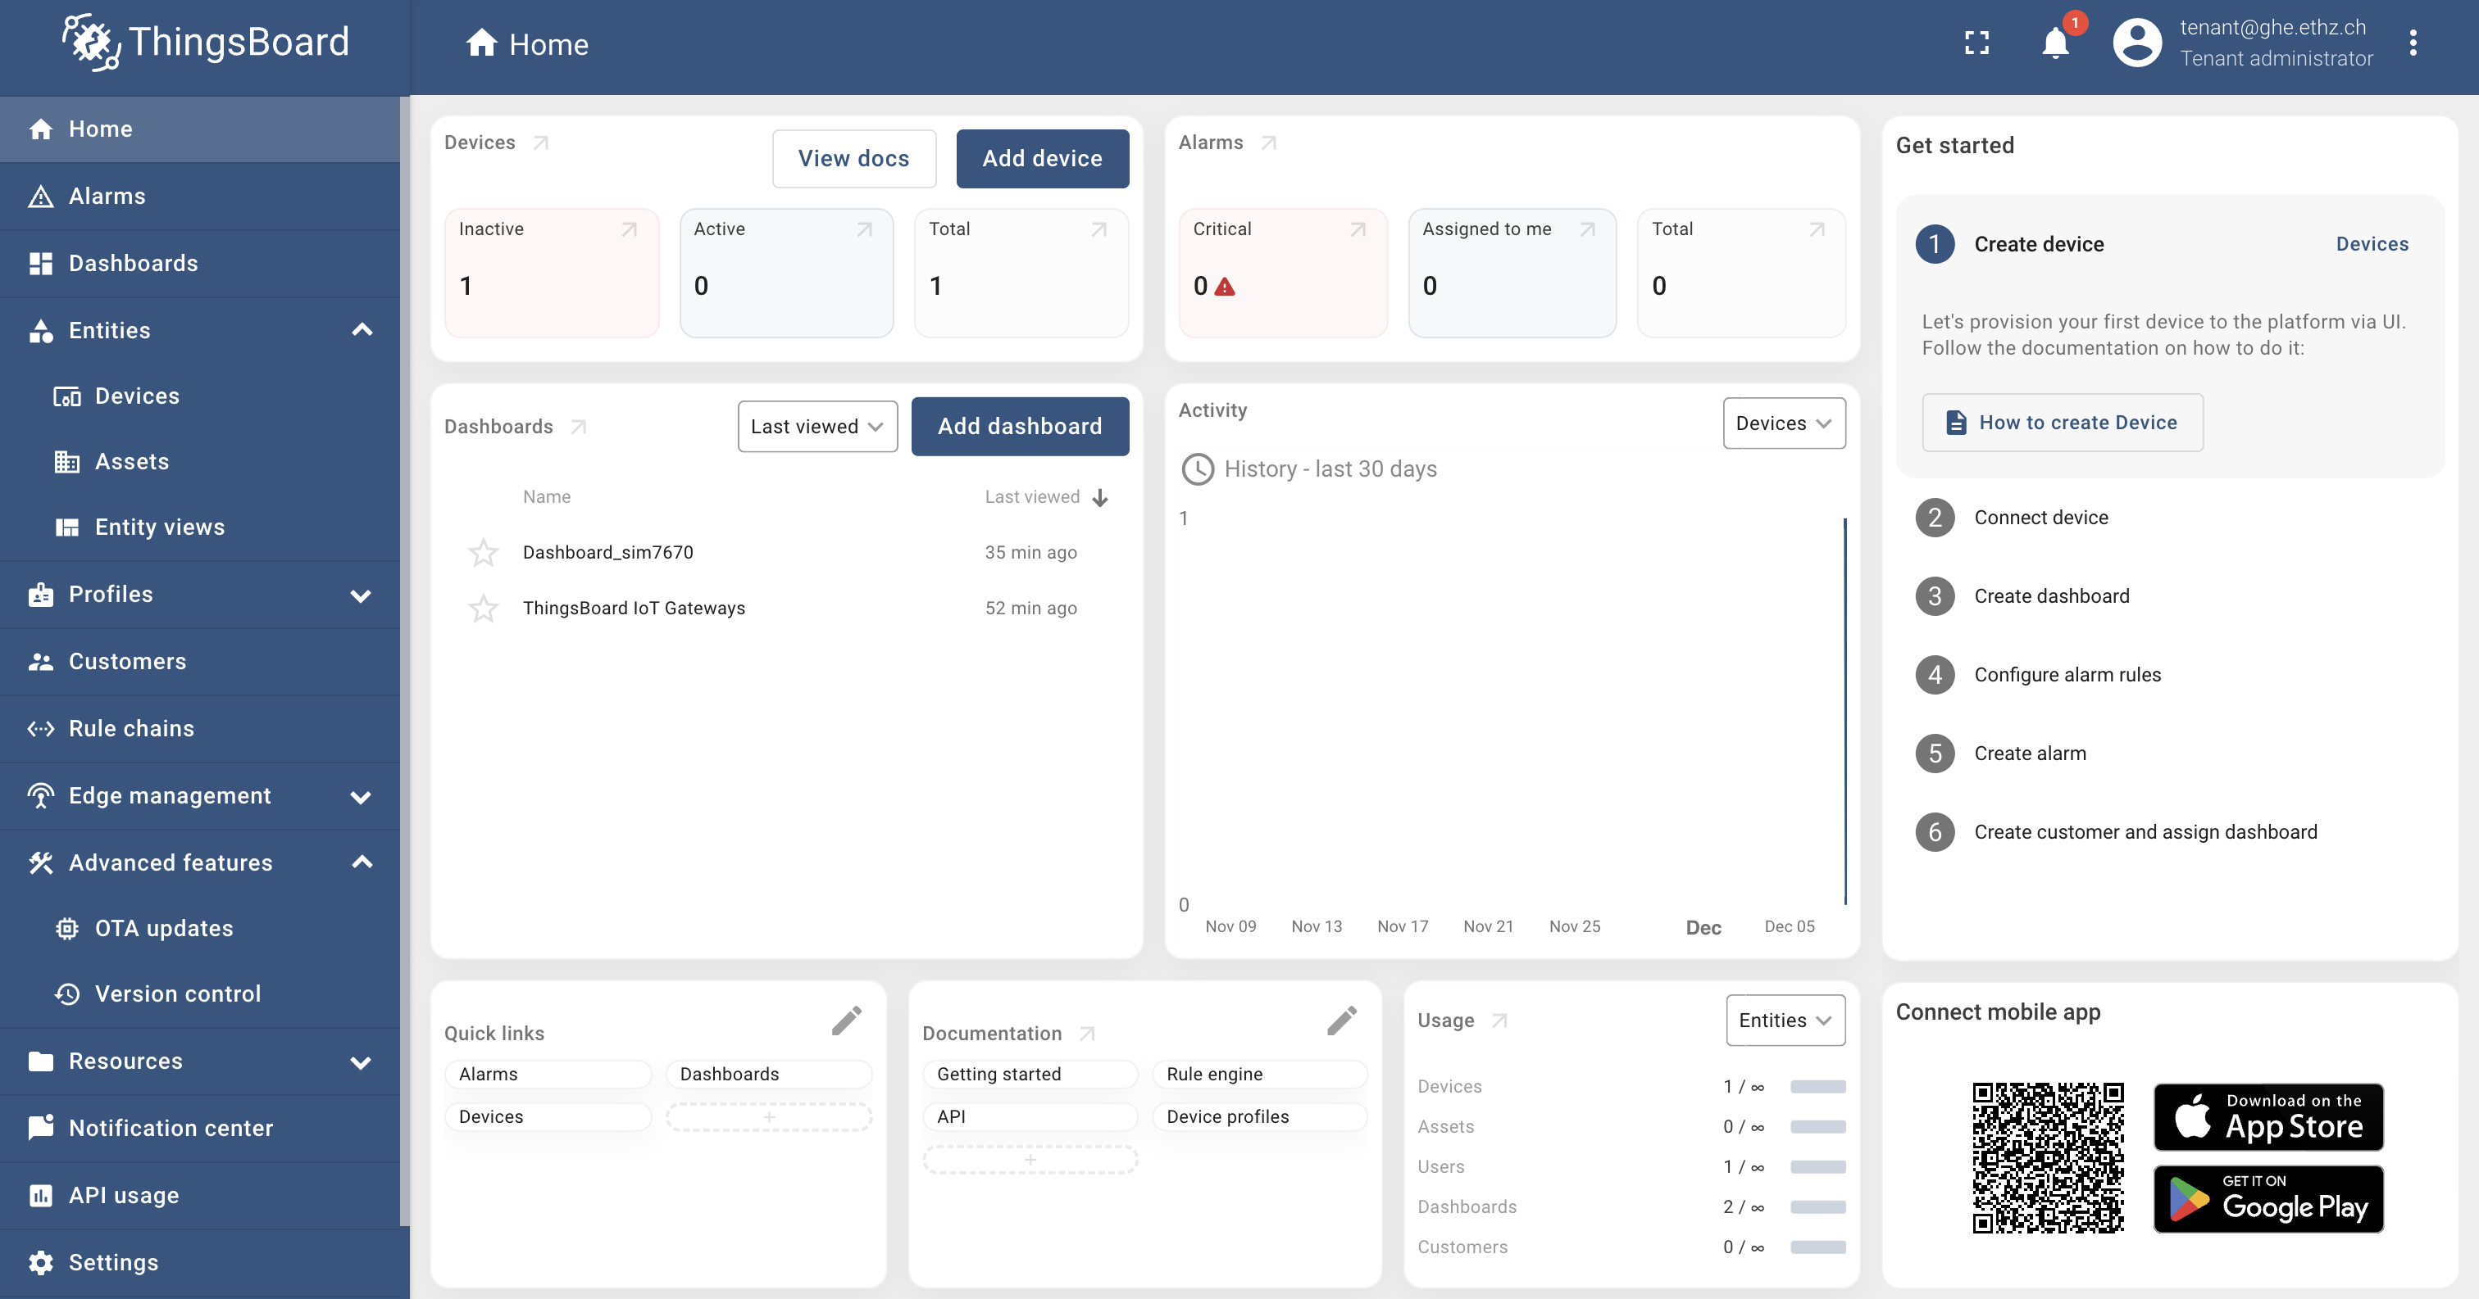
The dashboard (as a tenant)

Slide 5
Features
Dashboards: widgets to display data and control devices
Profiles: define type of devices (e.g. gas meter, wood cookstove meter)
Entities: devices & assets (e.g. gas meter 1, gas meter 2)
Customers: people who can see the dashboards
Rule chains: what happens to the data as it comes in (processing, alarms, verifying data…)

Slide 6
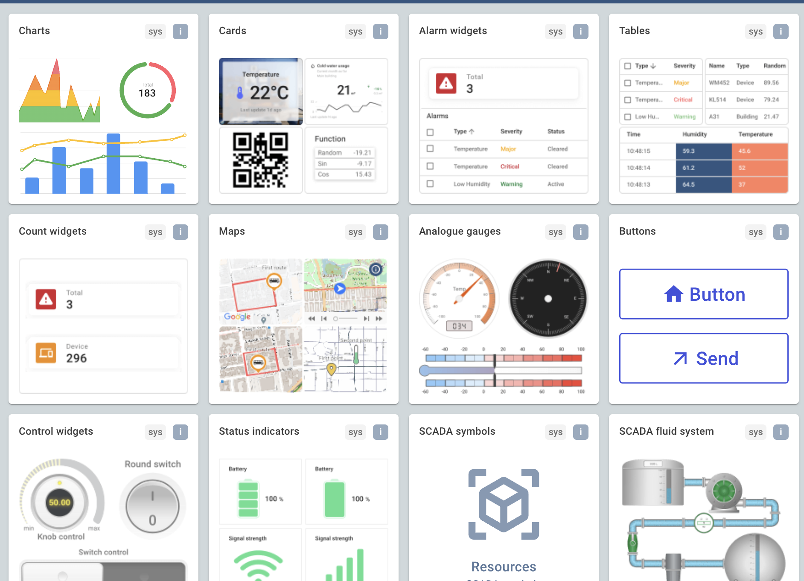
Dashboards

Slide 7
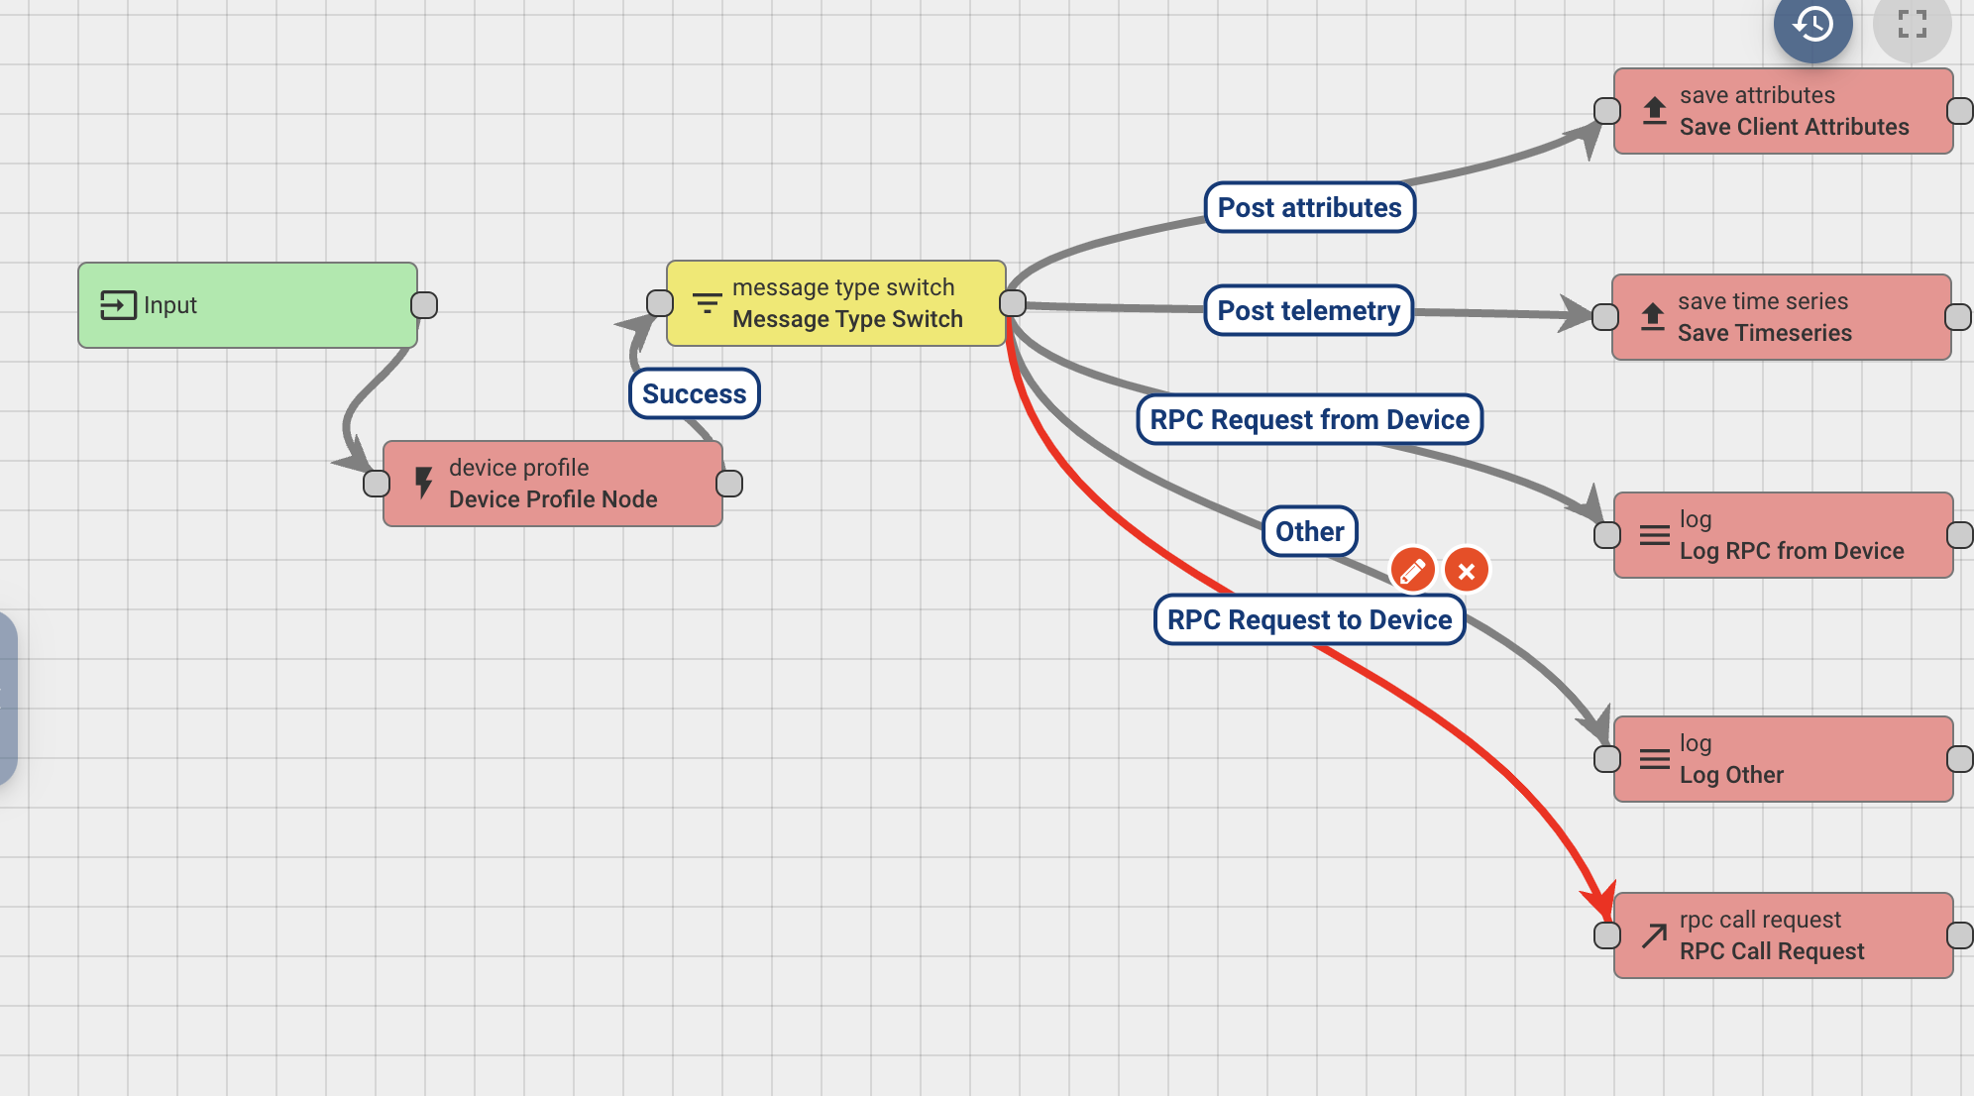
Rule chains

Slide 8
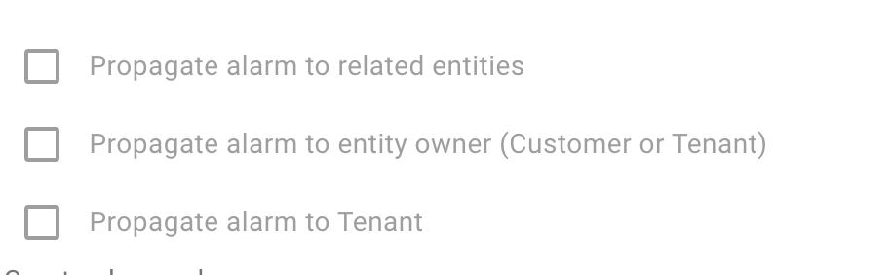
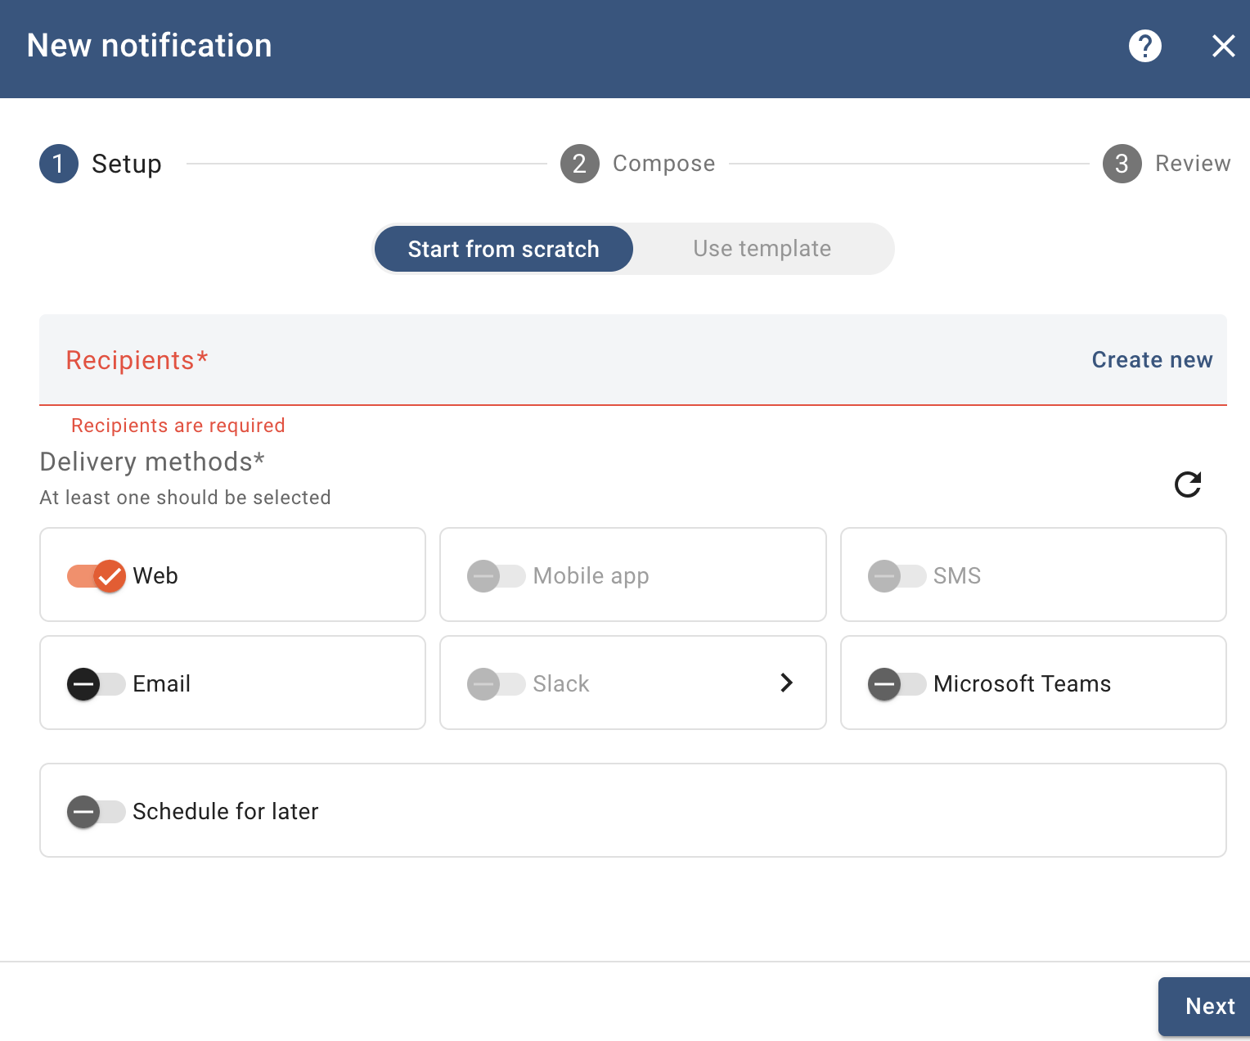
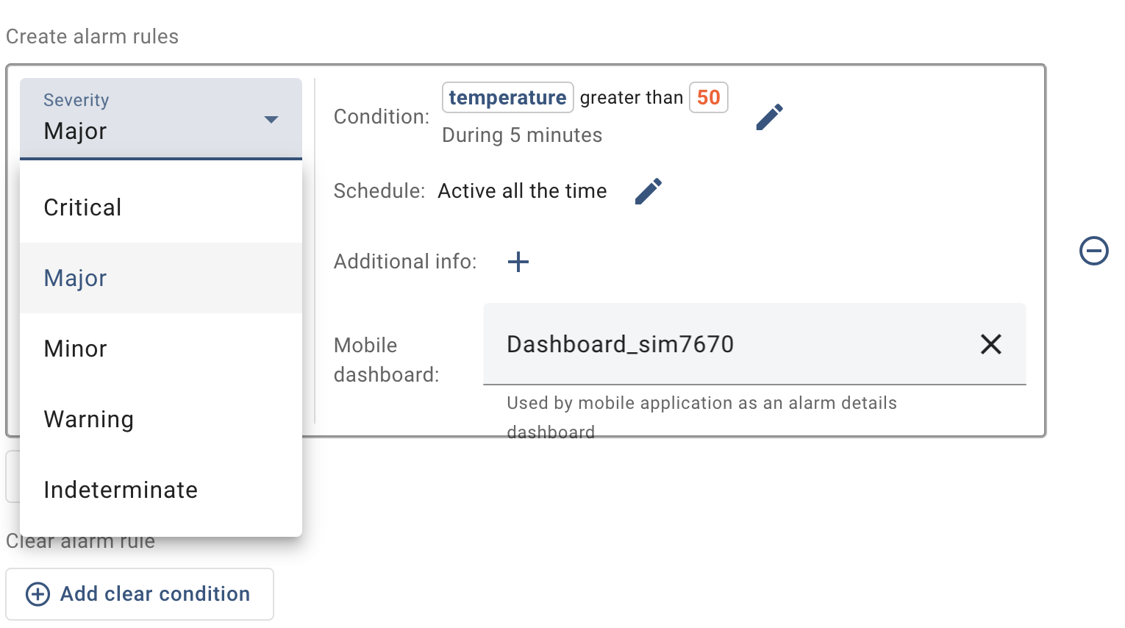
Alarms

Slide 9
Data privacy
We can run and deploy a server easily and manage it as system administrators → we have full control of tenant, customers and can see all data
Or we can provide them with a ready-made version of this that they can install on their computer and they are system administrators
Keep personal data out of the dashboard, no transmission (for now data transmission is unsecured)

Slide 10
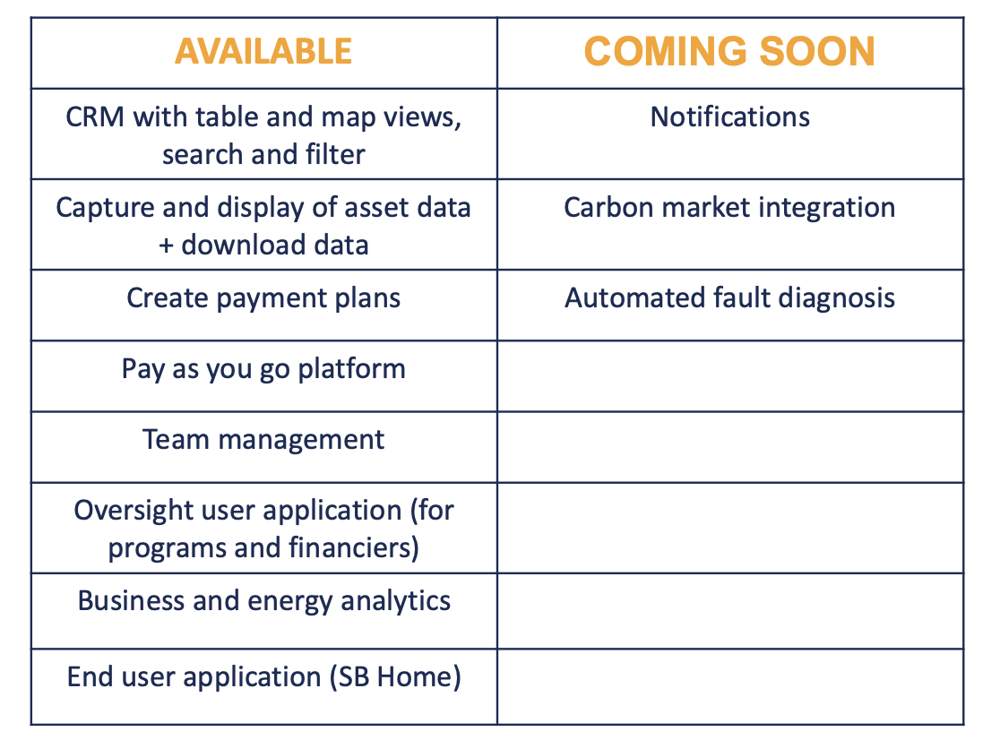

What is inclusive energy doing?
Thingsboard can do
We’d have to develop
Looking at the available source code and profiles of their (4) software engineers:
Custom-built app running on a Heroku server
Using MQTT

Slide 11
For now, thingsboard is enough

